Slide 1
Drop.in
E-Commerce Website
Project Undertaken:-
Riya Narain
Tushar Saxena

Slide 2
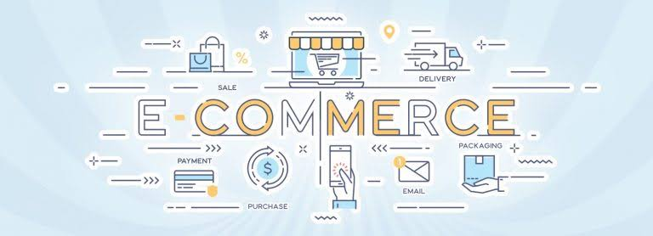
E-commerce is the new trend for buisnesses.
Hence, go with the flow!!!
Why e-commerce?

Slide 3


drop.in
Why not? E-commerce is now in demand
Everyone is lazy Online shopping is more convinient.
Boosting sales Easy for marketing and targeting
Make improvements Analyse data easily
New Create target audience and trends

Slide 4
Platform used:
FrontEnd
HTML5,CSS,BOOTSTRSAP
BackEnd
PHP
Database
MySQL

Slide 5
HTML 5
HTML5 is the latest evolution of the standard that defines HTML. The term represents two different concepts. It is a new version of the language HTML, with new elements, attributes, and behaviors, and a larger set of technologies that allows the building of more diverse and powerful Web sites and applications. This set is sometimes called HTML5 & friends and often shortened to just HTML5.
Semantics: allowing you to describe more precisely what your content is.
Connectivity: allowing you to communicate with the server in new and innovative ways.
Offline and storage: allowing webpages to store data on the client-side locally and operate offline more efficiently.
Multimedia: making video and audio first-class citizens in the Open Web.
2D/3D graphics and effects: allowing a much more diverse range of presentation options.
Performance and integration: providing greater speed optimization and better usage of computer hardware.
Device access: allowing for the usage of various input and output devices.
Styling: letting authors write more sophisticated themes.

Slide 6
Cascading Style Sheets (CSS) is a stylesheet language used to describe the presentation of a document written in HTML or XML (including XML dialects such as SVG, MathML or XHTML). CSS describes how elements should be rendered on screen, on paper, in speech, or on other media.
CSS
Using external CSS stylesheets
<link href="style.css" rel="stylesheet" type="text/css">
Using inline styles
<h1 style="color:red;margin-left:20px;">Today’s Update</h1>
Using internal CSS stylesheets

Slide 7
Bootstrap is an open-source Javascript framework developed by the team at Twitter.
It is a combination of HTML, CSS, and Javascript code designed to help build user interface components.
Bootstrap was also programmed to support both HTML5 and CSS3.
Also it is called Front-end-framework.
Bootstrap is a free collection of tools for creating a websites and web applications.
It contains HTML and CSS-based design templates for typography, forms, buttons, navigation and other interface components, as well as optional JavaScript extensions.
BOOTSTRAP
Some of the components pre styled are:
Dropdowns
Button Groups
Navigation Bar
Breadcrumbs
Labels & Badges
Alerts
Progress Bar
And many others.

Slide 8
PHP (a recursive initialism for PHP: Hypertext Preprocessor) is an open-source server-side scripting language that can be embedded into HTML to build web applications and dynamic websites.
PHP
Tip
Don’t wait till the end of theion to give the bottom line.
Reveal your product or idea (in this case a translation app) up front.

Slide 9
SQL is used to communicate with a database. According to ANSI (American National Standards Institute), it is the standard language for relational database management systems. SQL statements are used to perform tasks such as update data on a database, or retrieve data from a database
SQL
SQL is case insensitive. But it is a recommended practice to use keywords (like SELECT, UPDATE, CREATE, etc) in capital letters and use user defined things (liked table name, column name, etc) in small letters.
We can write comments in SQL using “–” (double hyphen) at the beginning of any line.
SQL is the programming language for relational databases (explained below) like MySQL, Oracle, Sybase, SQL Server, Postgre, etc. Other non-relational databases (also called NoSQL) databases like MongoDB, DynamoDB, etc do not use SQL
Although there is an ISO standard for SQL, most of the implementations slightly vary in syntax. So we may encounter queries that work in SQL Server but do not work in MySQL.
.

Slide 10

WEBSITE
In this website we have basically 2 modules. The first module includes the customer portal and second module includes admin portal.
The customer have to register for any enquiry related to products. The registered customer can view details of products and he/she can buy the product of his/her need. He/she has to pay and will get home delivery accordingly.
The admin portal contains the access of admin page on the website. The admin can change everything in the website. He have the ability to add, delete, and update any information regarding the product, set it's prices and look at the count of orders on a particular product that people have opted for in a particular time slot.
Our project is dropin This is a website which helps customers to find and buy all type of products on internet. It is useful in the way that it makes an easier way to buy and makes them available at a lower price dropin is an interactive e-commerce solution providing users with an opportunity to order products on the basis of how low they want to pay.

Slide 11
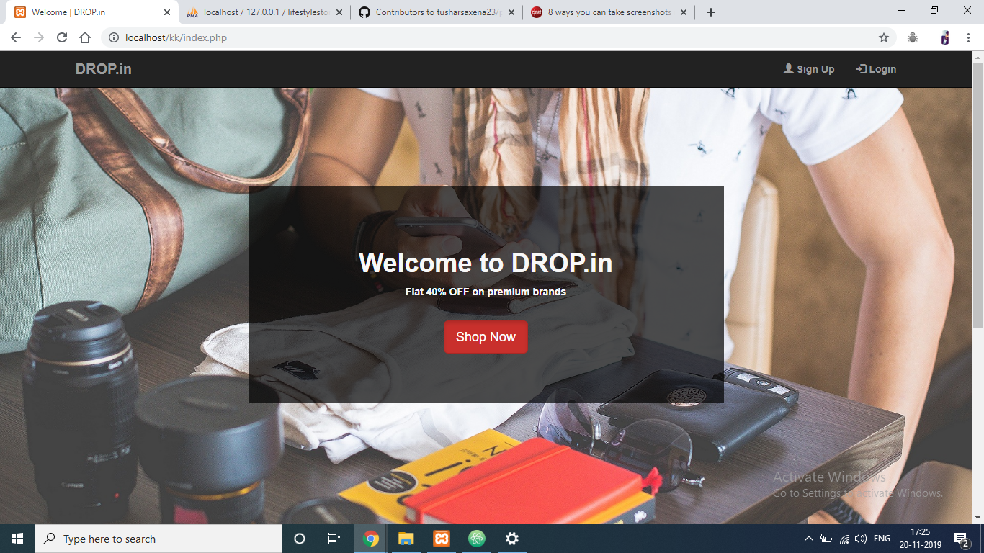
homepage

Slide 12
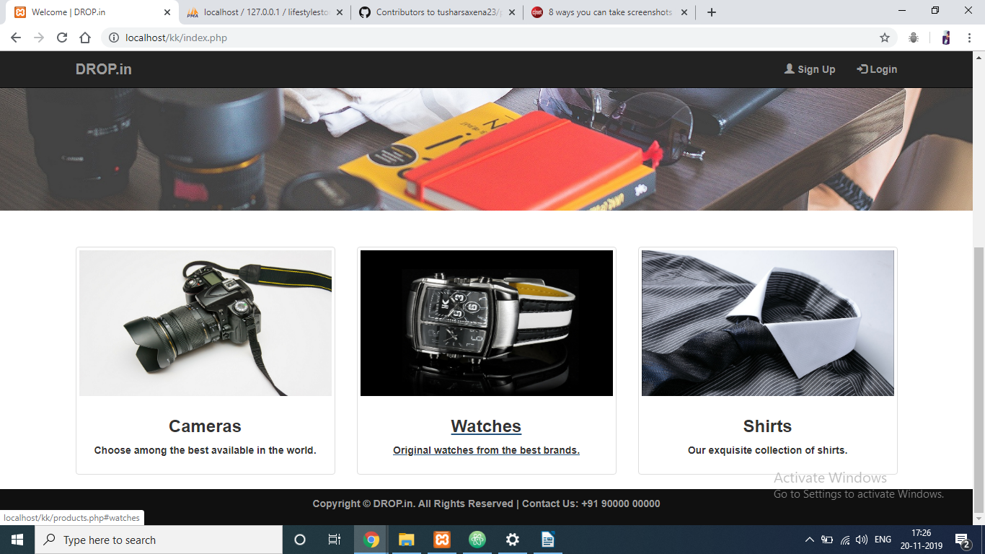

Slide 13
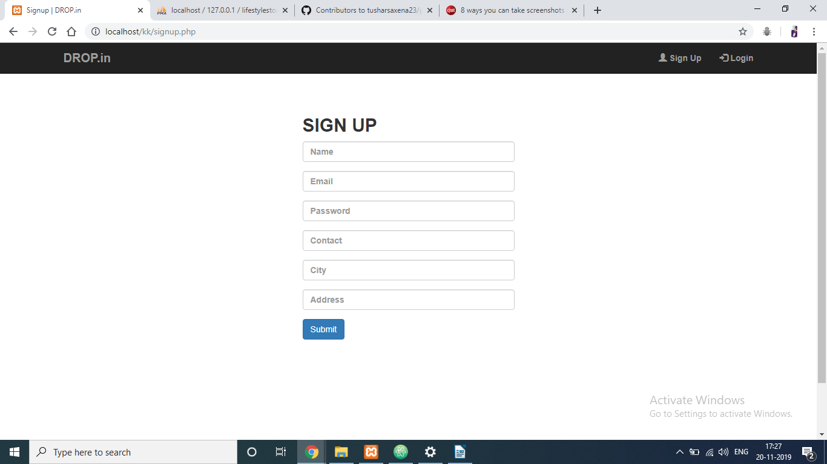
SIGNUP

Slide 14
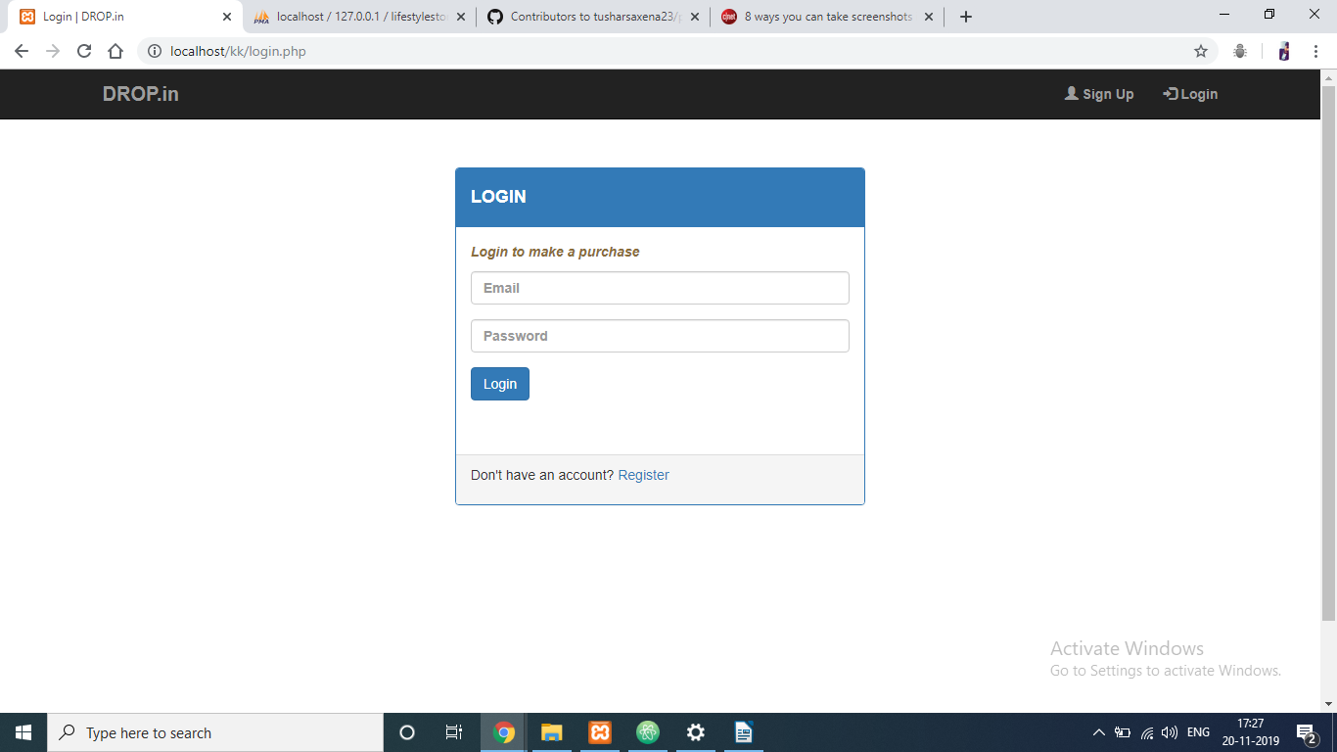
USER LOGIN

Slide 15
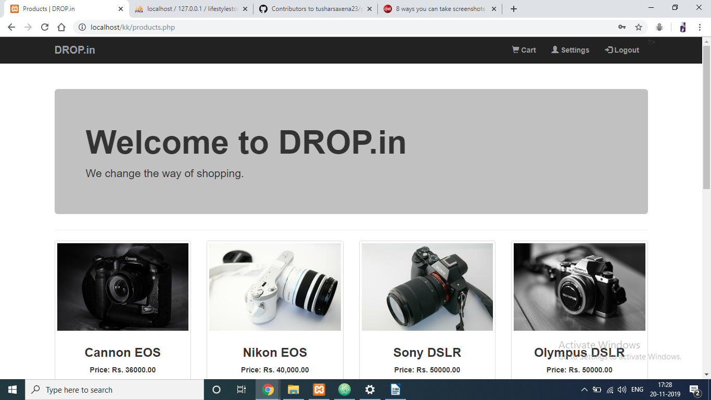
PRODUCTS

Slide 16
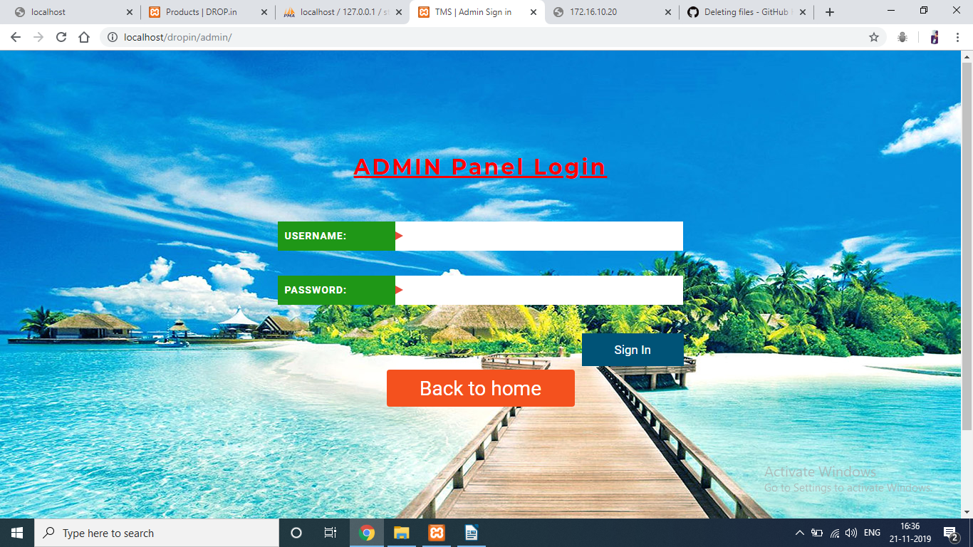
ADMIN PORTAL

Slide 17
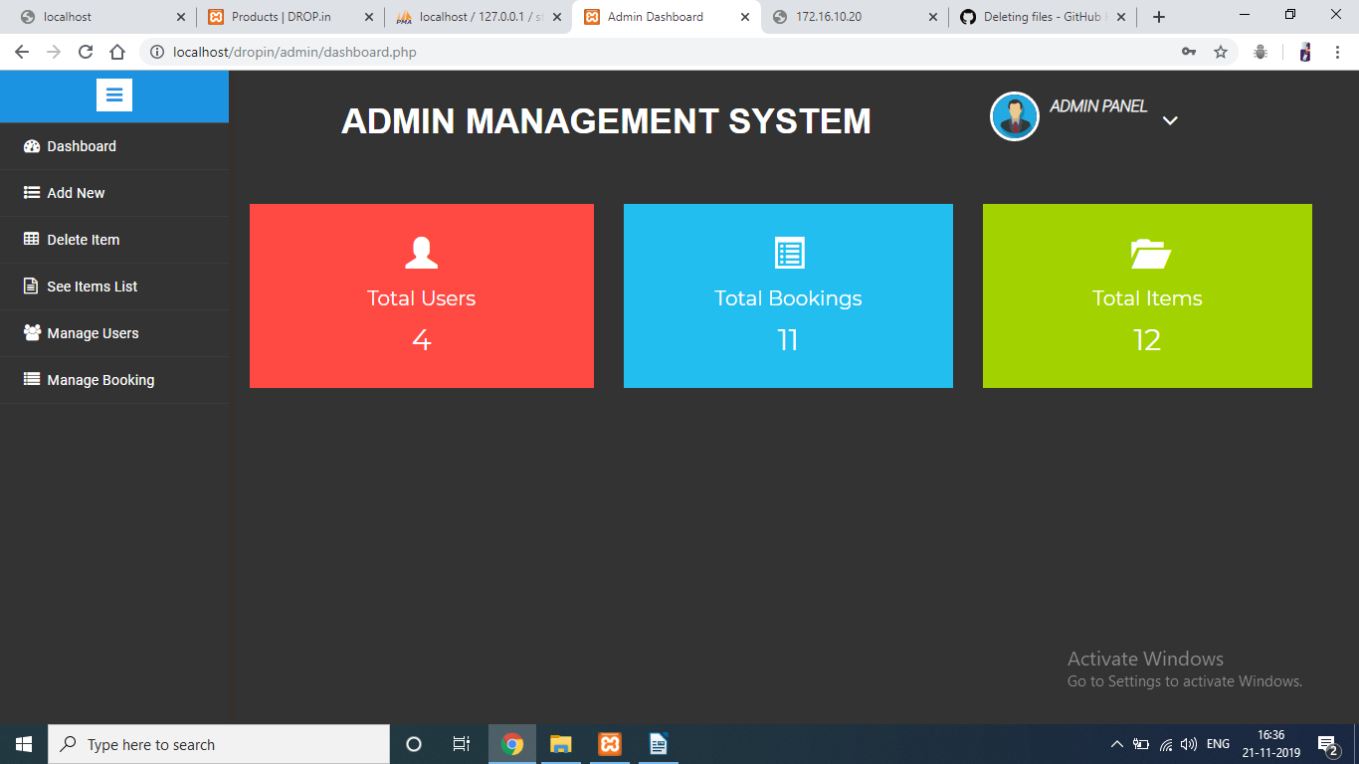
DASHBOARD

Slide 18
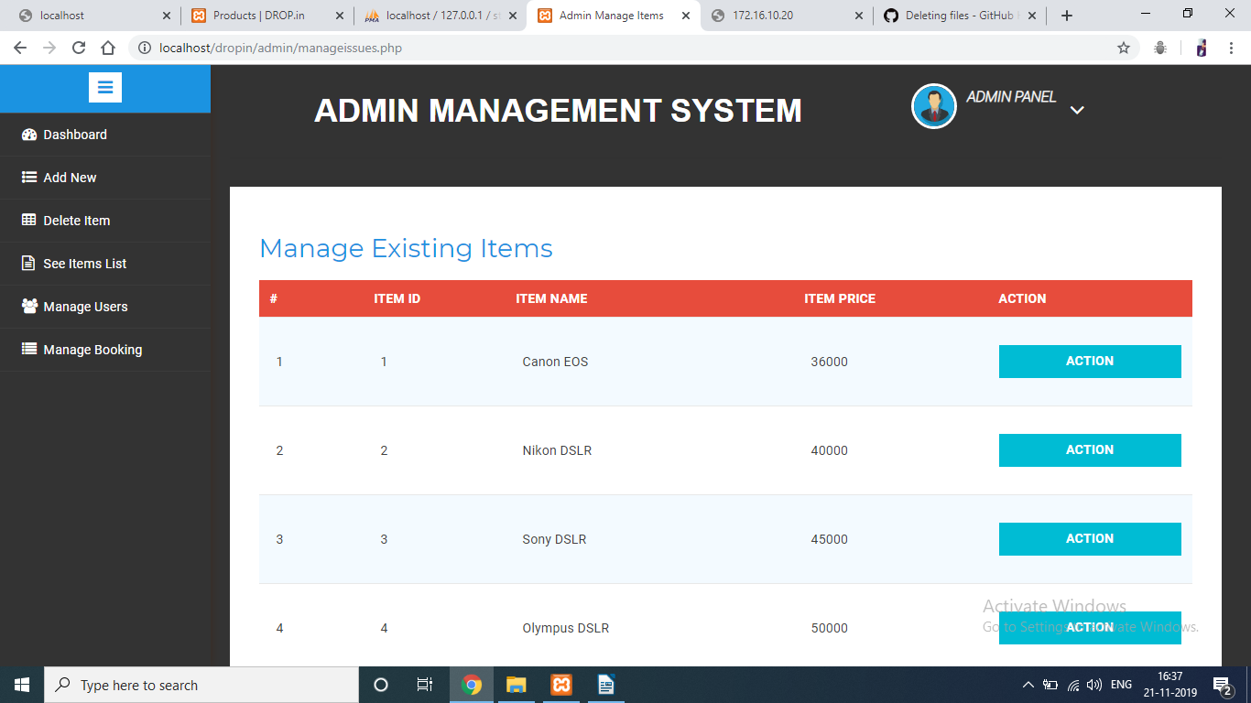
DELETE ITEMS

Slide 19
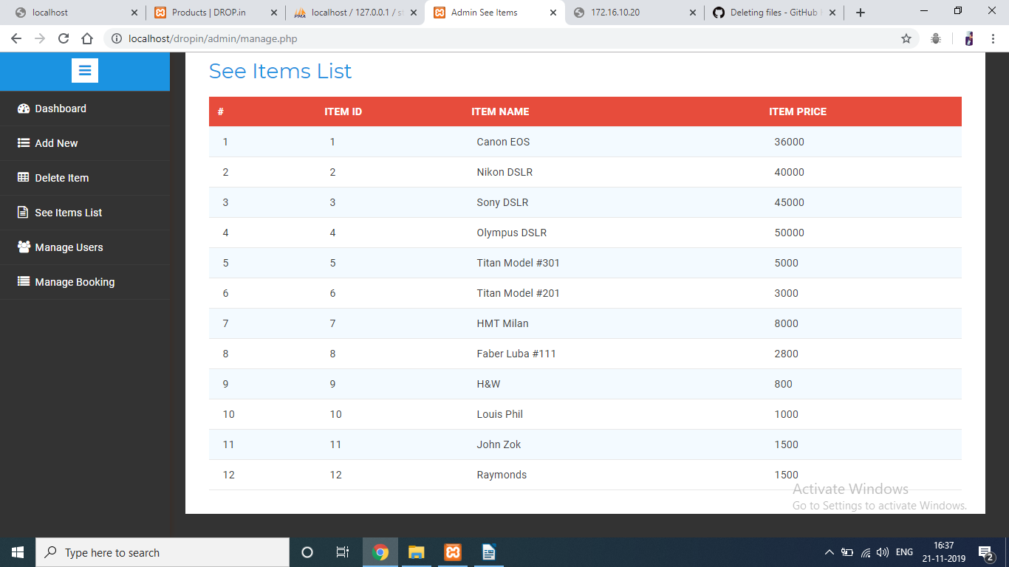
ITEM LIST

Slide 20
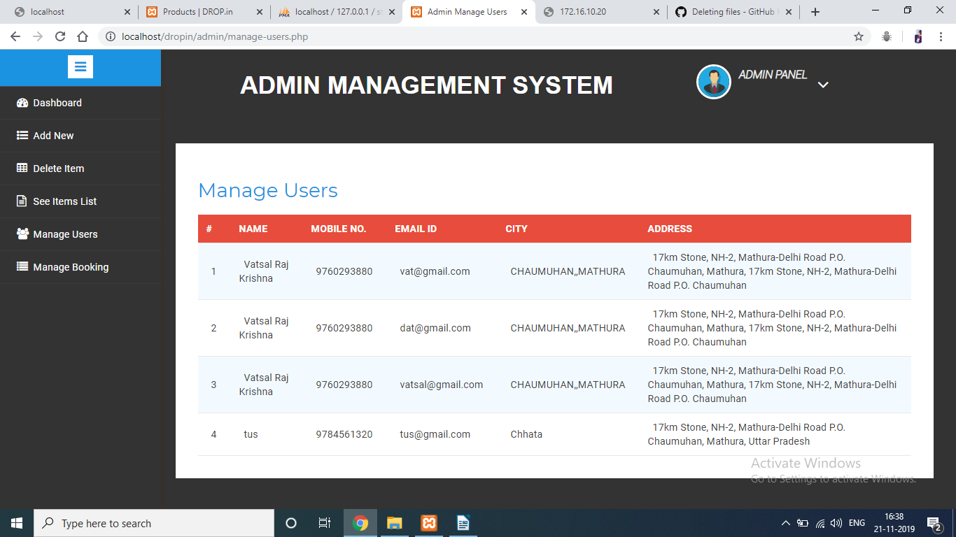
USER LOGINS

Slide 21
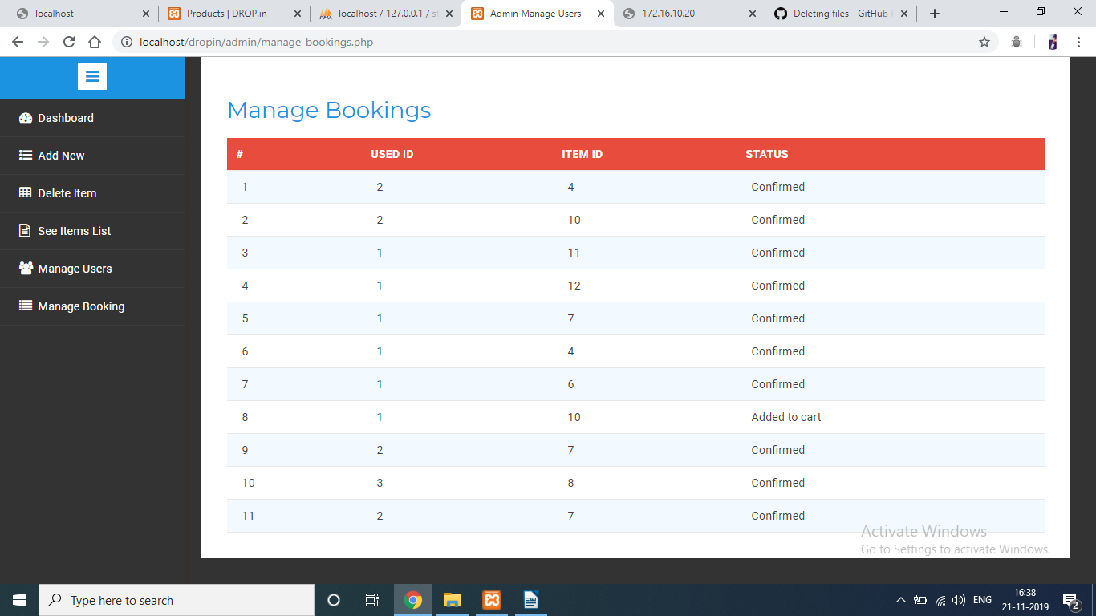
MANAGE BOOKINGS

Slide 22
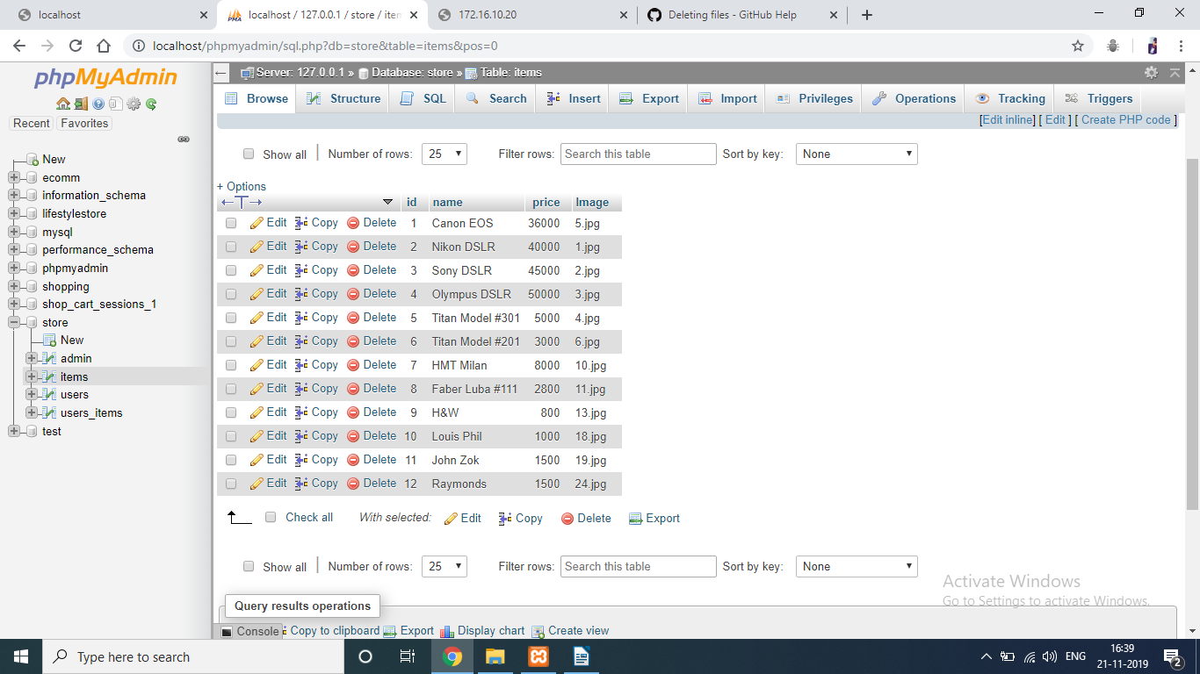
DATABASE

Slide 23

THANK YOU!!!

